Slide 1


Climate Change Impact Analysis
Statistical Machine Learning course project on temperature-rainfall relationship.
Submitted by Shantanu Chaturvedi(E23CSEU1997), Gurram Manideep(E23CSEU1986), Raman(E23CSEU2005).
AK
Notes:
1

Slide 2
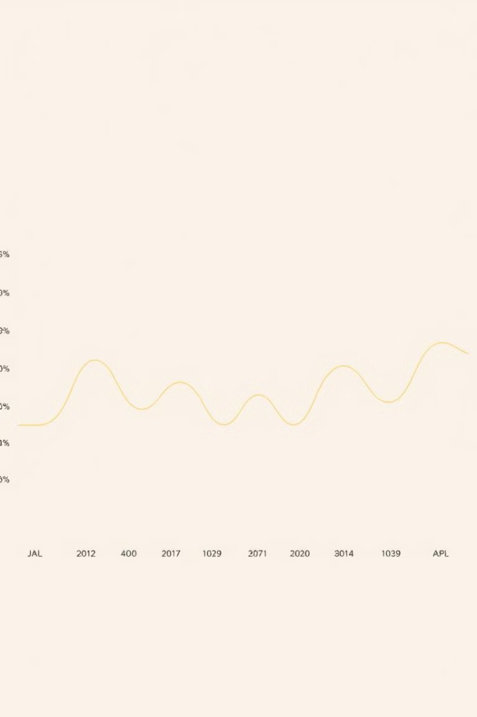
Abstract
1
Objective
2
Data Source
Analyze the impact of climate change on rainfall patterns in Assam using statistical models.
NASA POWER CERES/MERRA2 dataset covering the period from 1981 to 2022.
3
Key Insights
Uncover the relationship between temperature and rainfall over time in the region.
Notes:
2

Slide 3
Introduction
Significance of Climate Data Analysis
Role of Machine Learning
Objective
Advanced statistical models can provide predictive insights into climate variability and its effects.
Use statistical models to analyze the relationship between temperature and rainfall in Assam.
Understanding the impact of climate change is crucial for sectors like agriculture, water resources, and energy planning.
Notes:
3

Slide 4
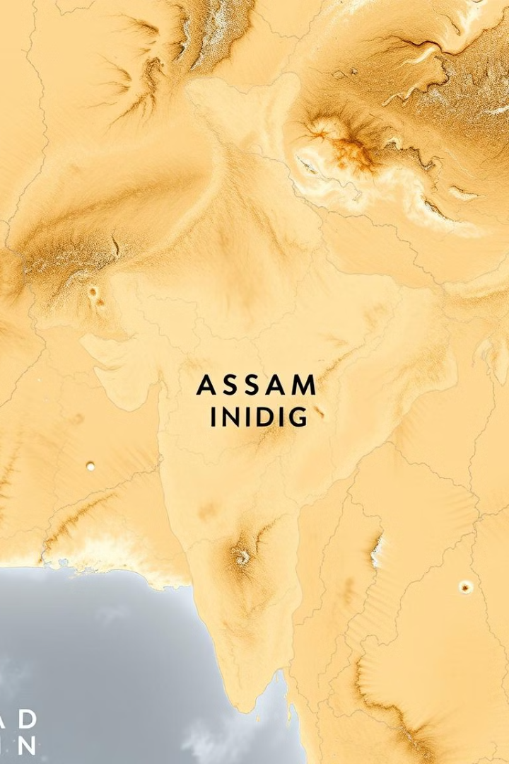
Methodology - Dataset Description
Data Source
Location
NASA POWER CERES/MERRA2 dataset
Latitude 26.2006, Longitude 92.9376 (Assam, India)
Parameters Analyzed
Temperature (°C) and Precipitation (mm)
Notes:
4

Slide 5

Methodology - Steps for Data Analysis and Modeling
Data Preparation
1
Import, clean, and select relevant columns from the dataset.
Feature Selection
2
Focus on temperature and precipitation as the key variables for analysis.
Data Transformation
3
Aggregate and normalize the data to facilitate effective modeling.
Notes:
5

Slide 6
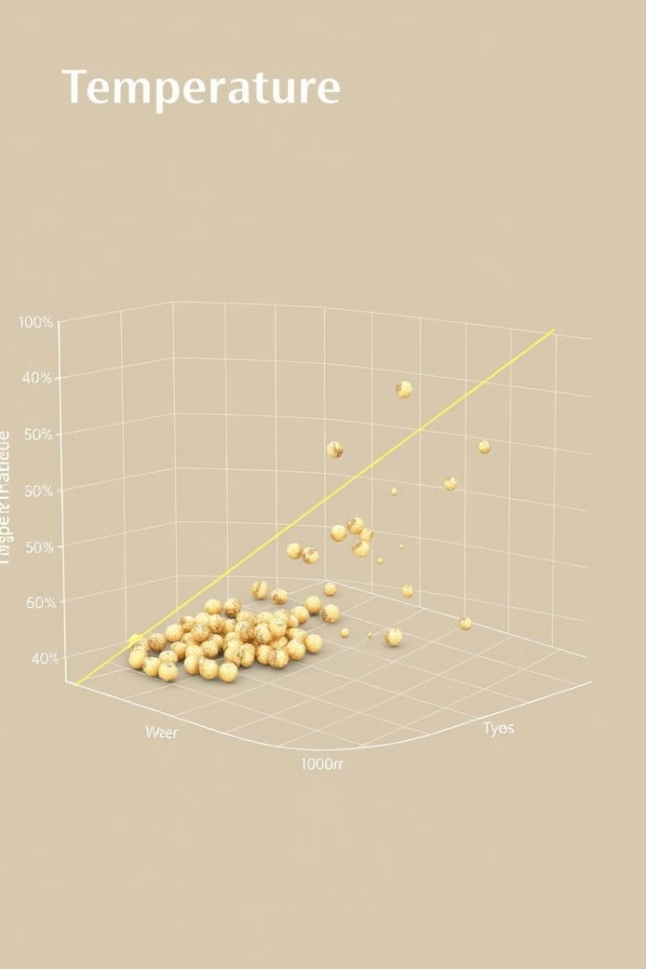
Model Development
Model Used
Target Variable
Linear Regression
Rainfall prediction using temperature
Data Split
Train-test split for model validation
Notes:
6

Slide 7
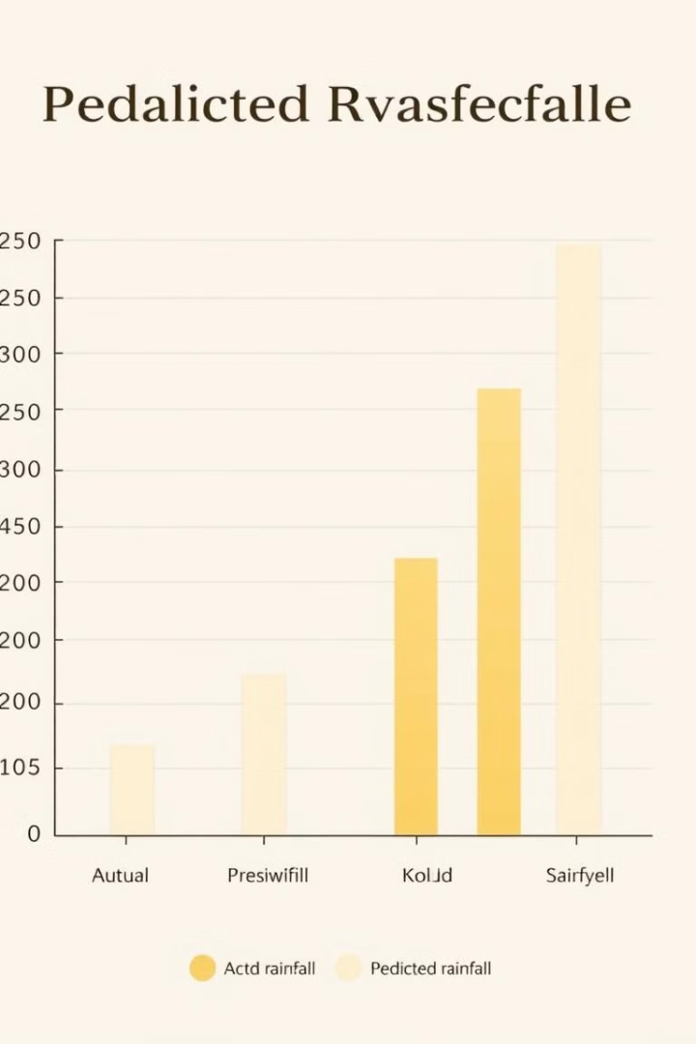
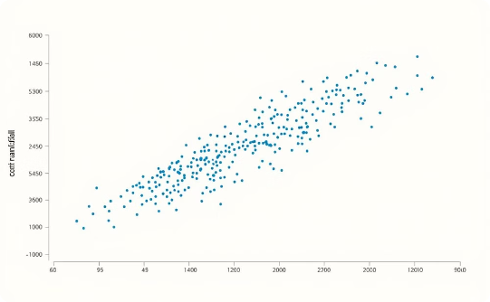
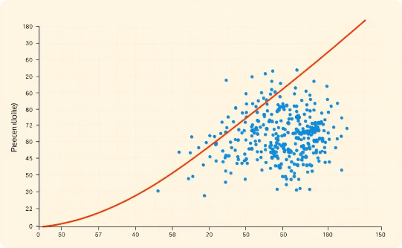
Experimental Results
1
Model Evaluation
2
Visualization
Metric: Mean Squared Error (MSE)
Plot of actual vs. predicted rainfall values
Actual Rainfall
Predicted Rainfall
Notes:
7

Slide 8

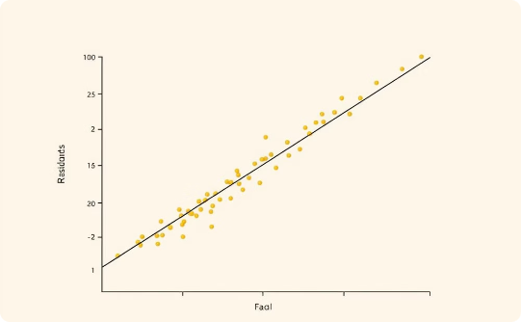
Conclusions
Findings
Observed relationship between temperature and rainfall, with insights on climate variability impacts.
Model Accuracy
Evaluated the performance of the linear regression model and discussed its limitations.
Notes:
8

Slide 9



Future Scope
Add Variables
Incorporate additional variables like humidity and wind speed to enhance the model's predictive power.
Explore Advanced Models
Experiment with more complex models, such as decision trees, random forests, and neural networks.
Notes:
9

